Slide 1
Building Blocks

Slide 2
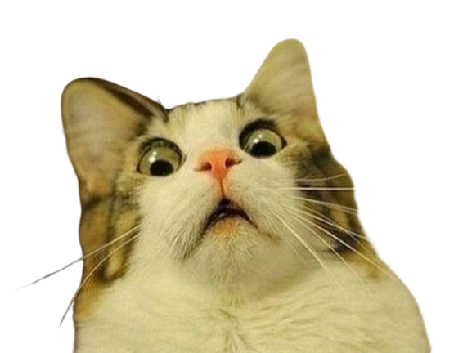
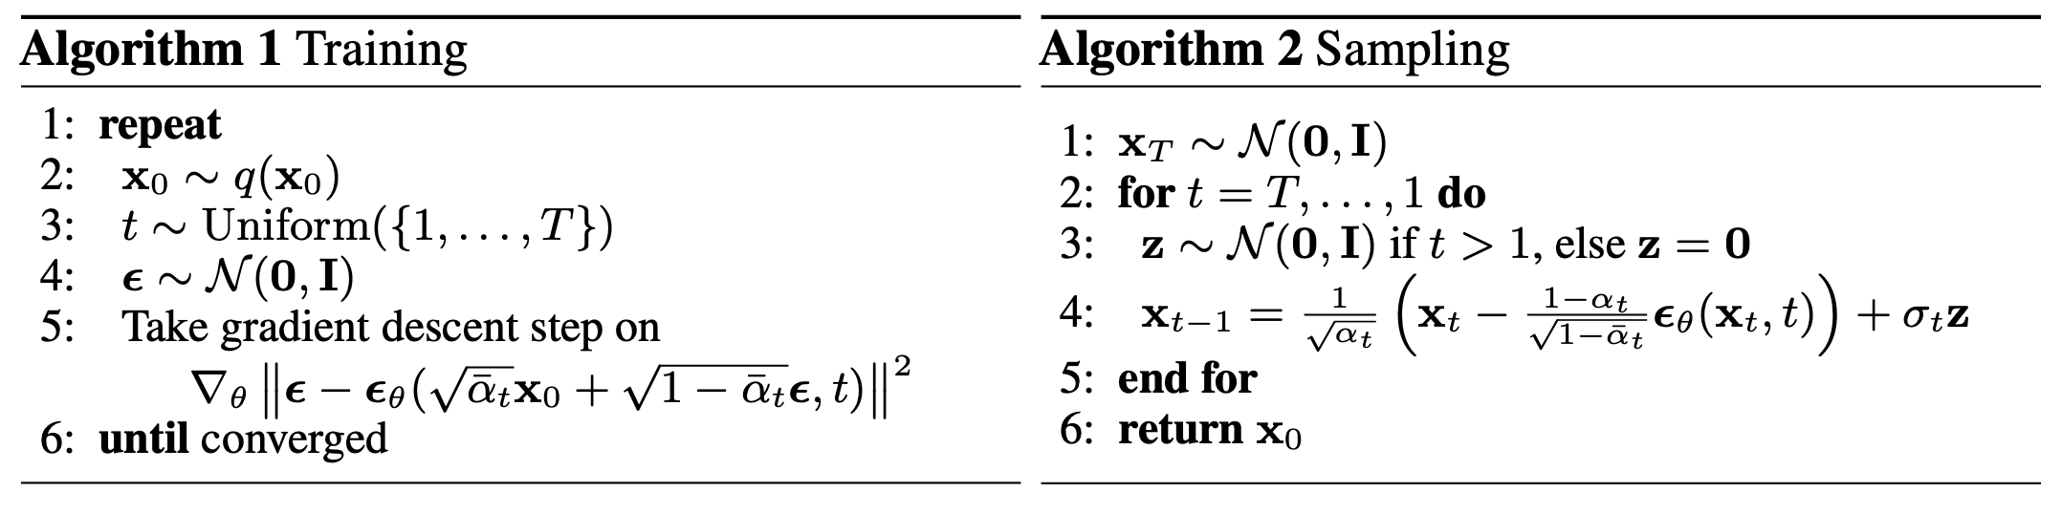
Building Blocks
Here is the algorithm for diffusion…
Notes:
By the end of the session today, I’m hoping that we can get at least a general idea of what these steps mean, without really caring too much about the mathematical detail…I’ll briefly explain the left hand algorithm now. It might not make too much sense immediately, but hopefully, later on, it should.
Get a random training sample
Draw a timestep uniformly at random from [1, T]
Generate some noise from a normal distribution
Feed your image plus noise into the model. The model will then try this noise value

Slide 3
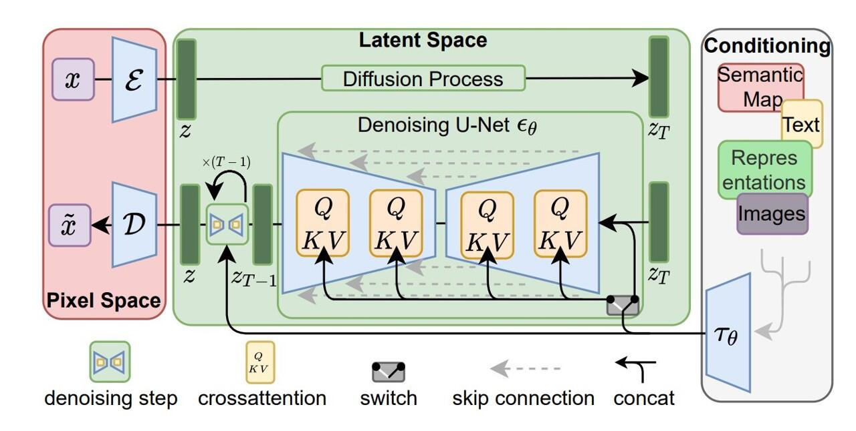
Building Blocks
Perhaps this makes more sense…

Slide 4
Building Blocks
Aims of this section:
By the end of the session we want to be able to understand the architecture.
We start with the architecture:
Variational Autoencoders
UNet
CLIP
And some common operations in deep learning:
Convolution
Normalization
Pooling
Residual connections
Upsampling

Slide 5
Variational Autoencoders
Notes:
My name is Ryan and I’m a machine learning engineer with the accelerate programme for scientific discovery. I’m just going to talk about accelerate, what we do, what we’ve done, and what we might be able to offer you.

Slide 6
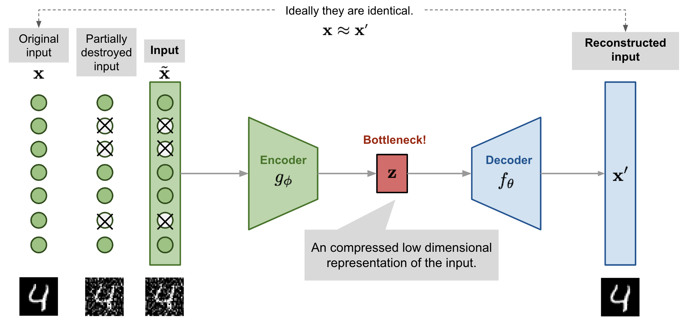
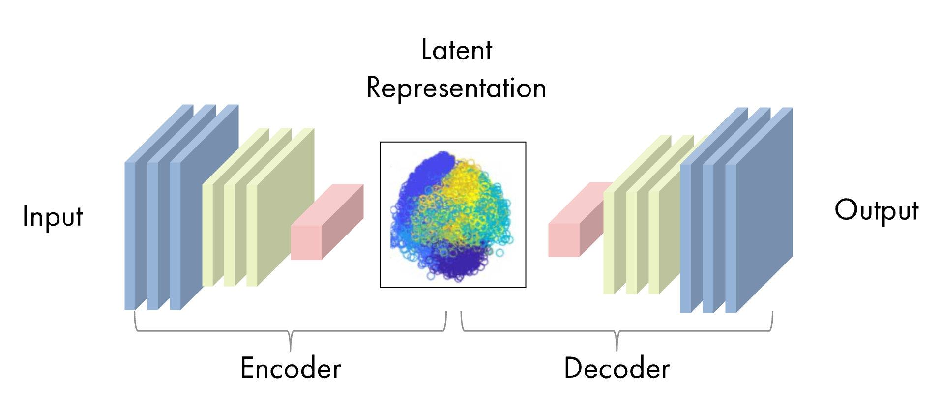
VAEs
A simple example…
Suppose you want to create a neural network that denoises images.
One way of doing this is by using an autoencoder…
Notes:
Pay attention to this structure, because it is going to come up again and again.

Slide 7
VAEs
But there are some issues with using this kind of autoencoder…
Gaps between latent points, where the model doesn’t really know what is supposed to be there
It is deterministic – the encoder will map input data to a single point in latent space and then decode it back to the original space.
This mapping limits the ability to generate samples
They are not really trying to model the underlying data distribution

Slide 8
VAEs
Instead of trying to build a latent space encoding, why not try and model a distribution…
We should try and map the input space to a latent distribution rather than a single point in space
We should therefore have a continuous and dense latent space
This will enable smooth interpolation between points
We impose restrictions on the latent space to force it to map the input data to the distribution that we want.
This distribution is the normal distribution. This is because we can draw from it easily, and computing gradients is also easy.

Slide 9
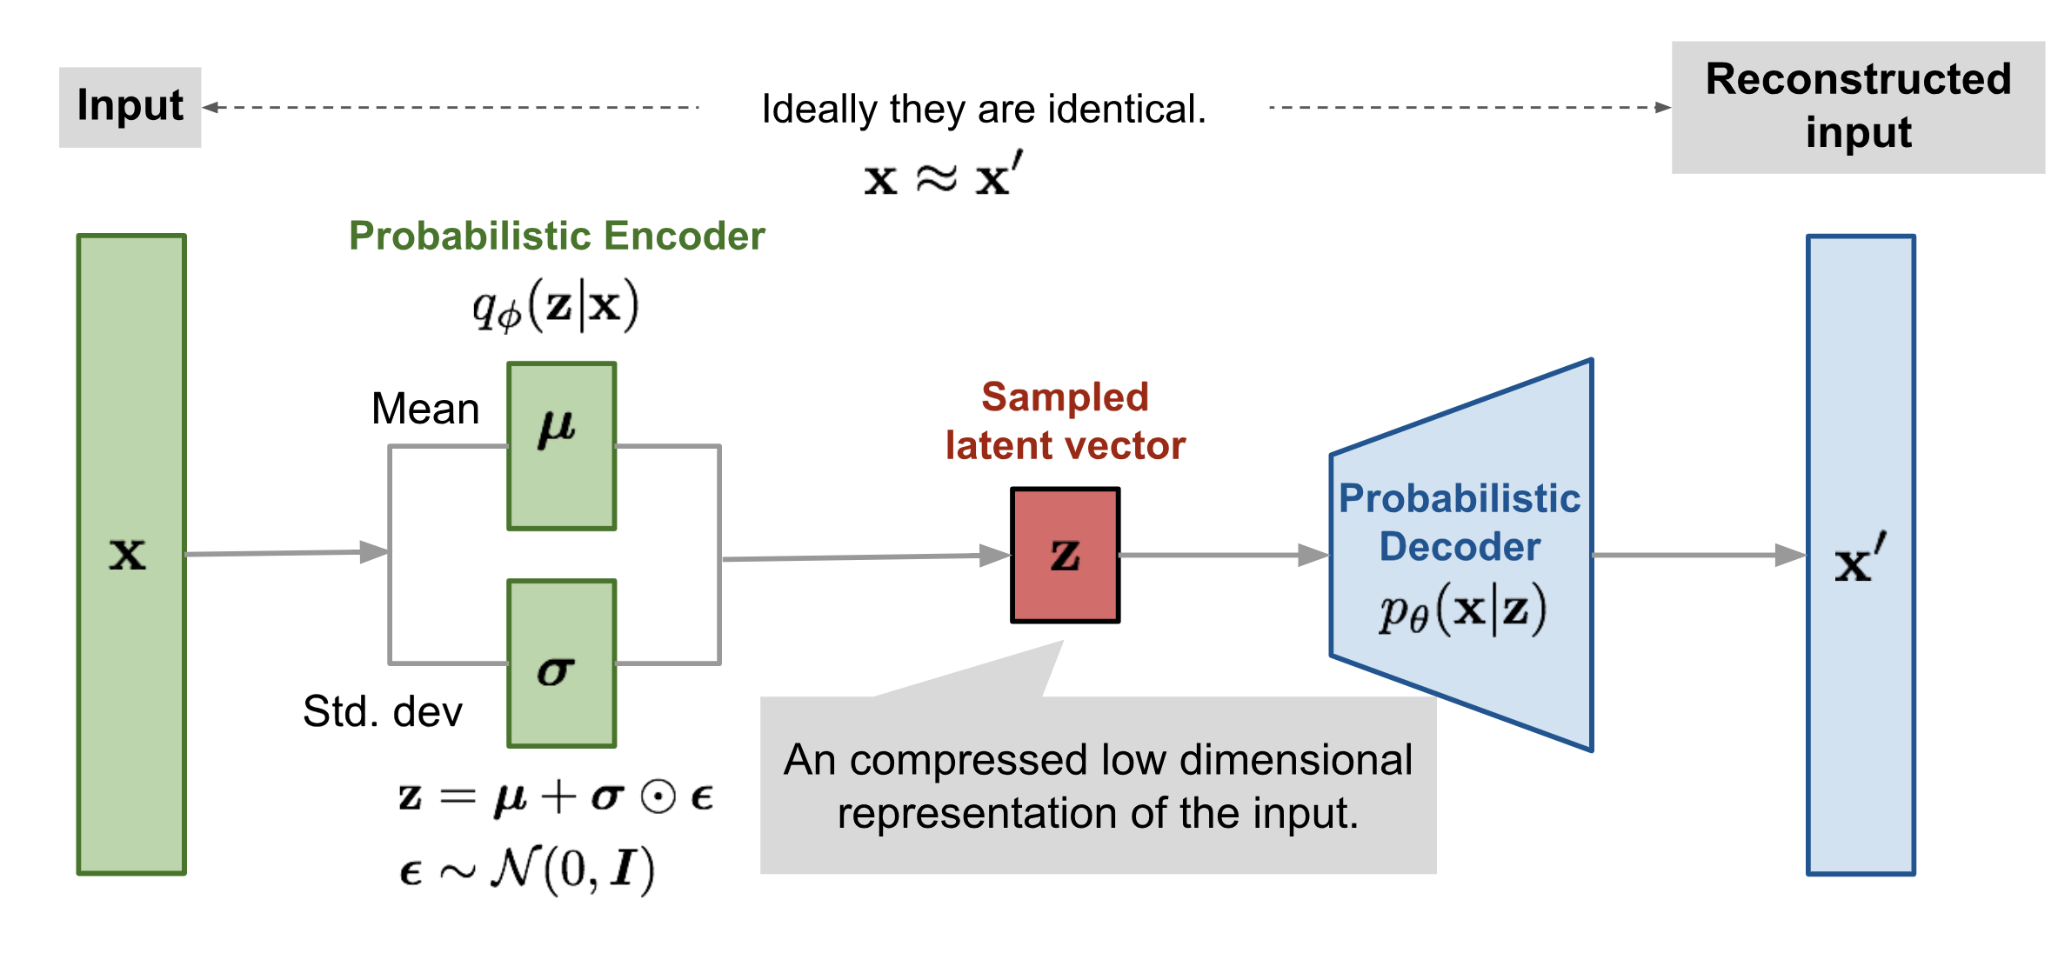
VAEs

Slide 10
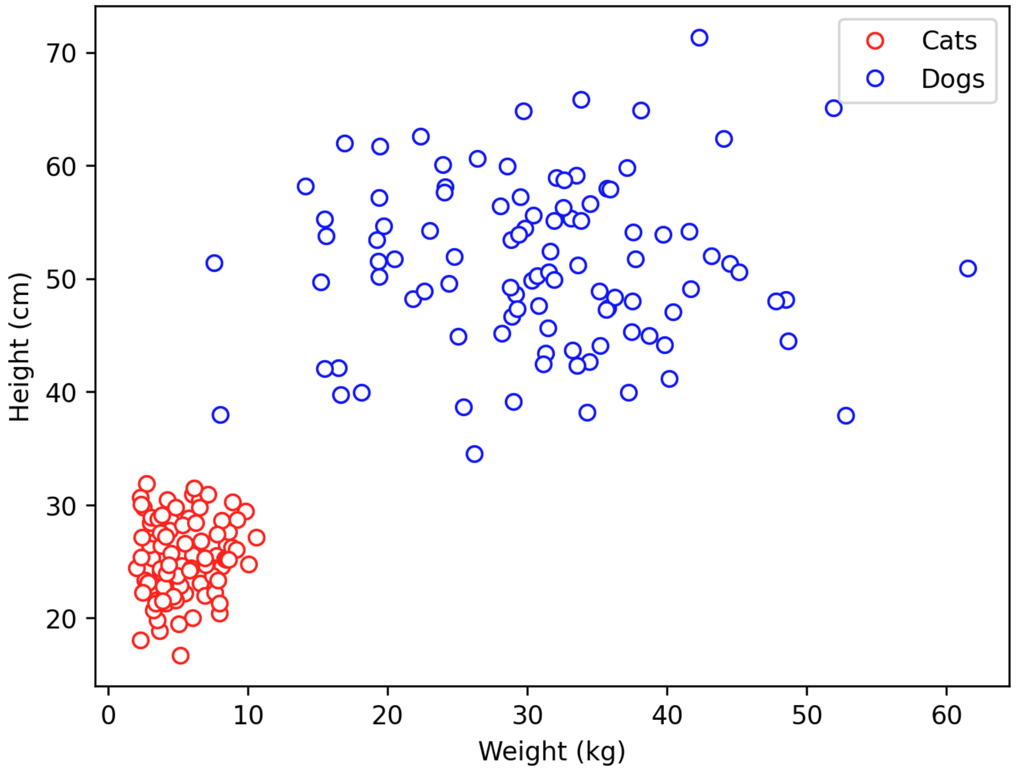
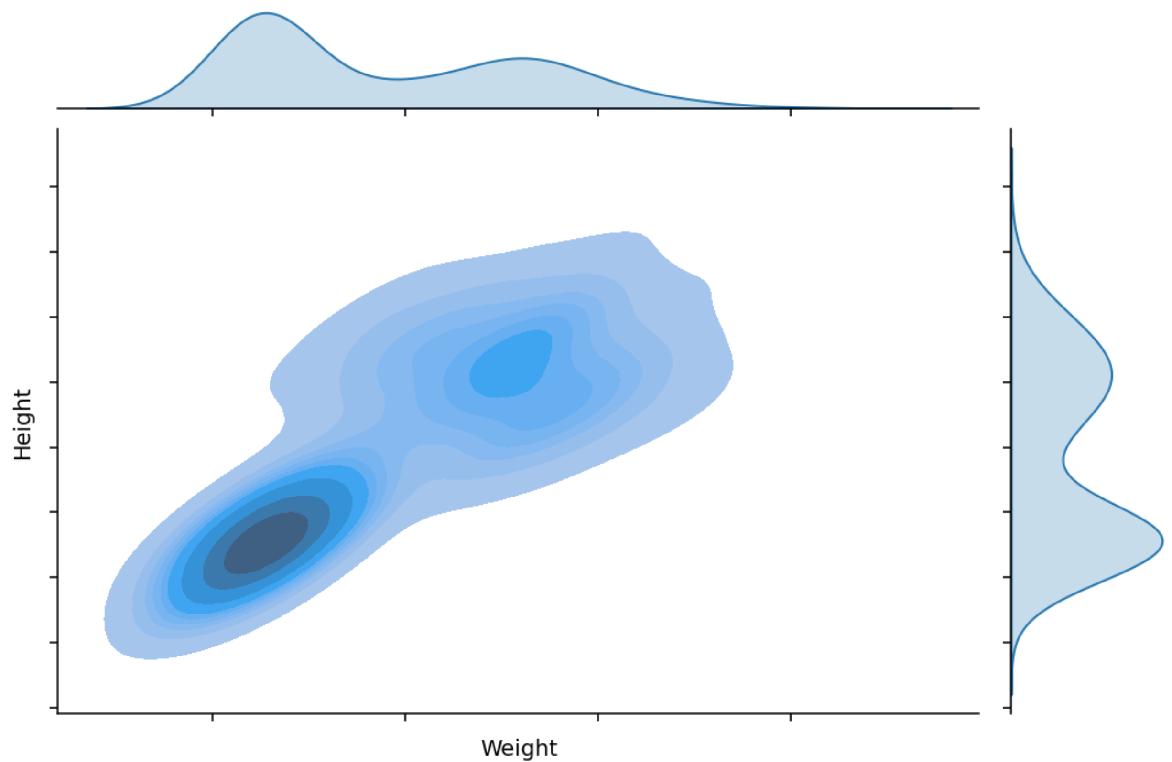
VAEs
Back to cats and dogs…
Notes:
Let’s look at this again…and think about our cat and dog example.
You can initially think of this as p(x) i.e. the distribution of our data. Obviously we can see it’s a mixture of Gaussians, because we can directly inspect it, but you won’t be able to do this with high dimensional spaces…

Slide 11
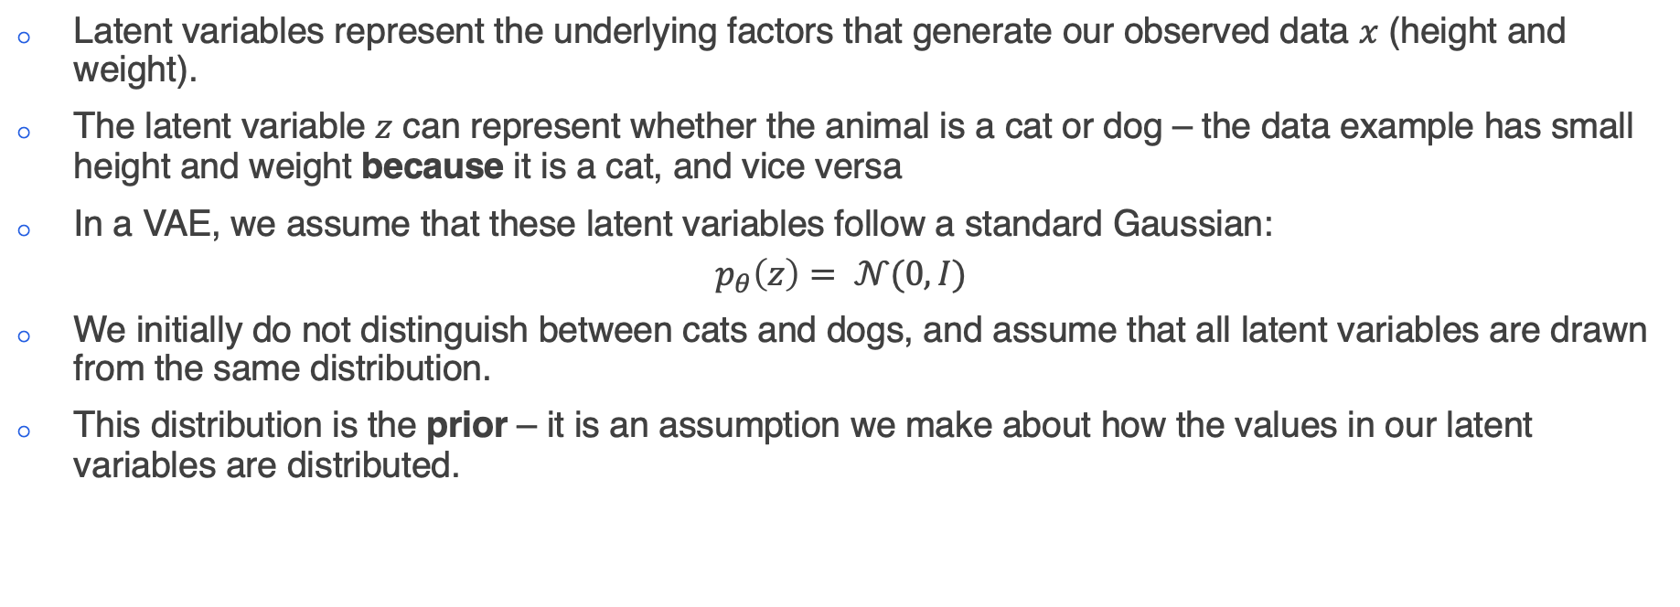
VAEs
Latent variables
Latent variables represent the underlying factors that generate our observed data $x$ (height and weight).
The latent variable $z$ can represent whether the animal is a cat or dog – the data example has small height and weight because it is a cat, and vice versa
In a VAE, we assume that these latent variables follow a standard Gaussian:
$$p_{θ}\left(z\right)= 𝒩(0,I)$$
We initially do not distinguish between cats and dogs, and assume that all latent variables are drawn from the same distribution.
This distribution is the prior – it is an assumption we make about how the values in our latent variables are distributed.
Notes:
In this case, my latent space is 1-dimensional, and binary. But for most examples, we assume that we have many latent variables, and they are continuous in nature (i.e can take on pretty much any value).
We usually restrict the values that the latent variables can take on, by making an assumption that they are normally distributed. This is our prior.

Slide 12
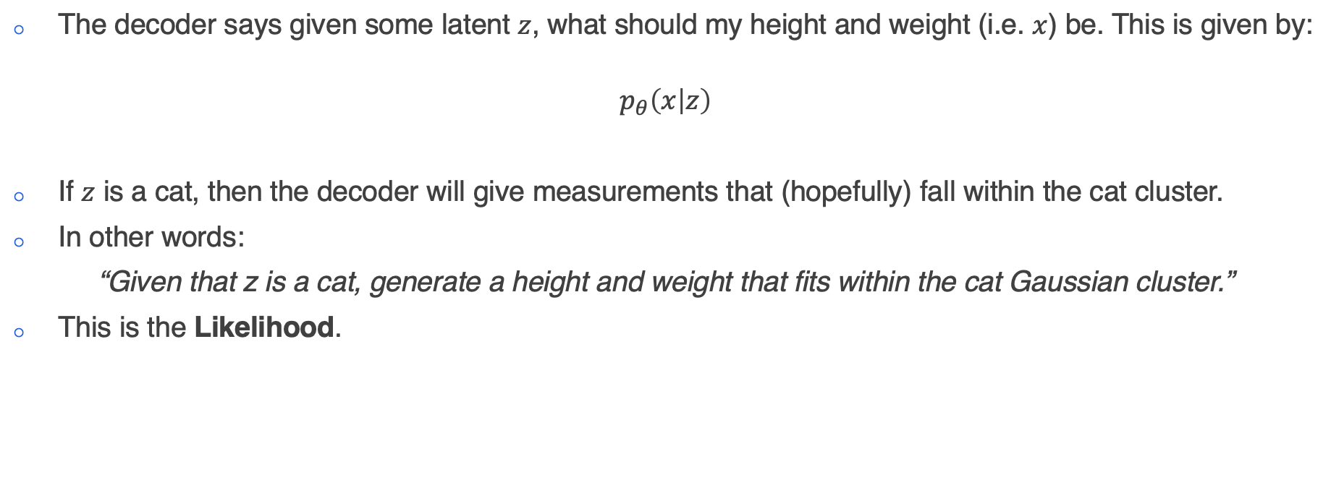
VAEs
Decoder
The decoder says given some latent $z$, what should my height and weight (i.e. $x$) be. This is given by:
$$p_{θ}\left(x | z\right)$$
If $z$ is a cat, then the decoder will give measurements that (hopefully) fall within the cat cluster.
In other words:
“Given that z is a cat, generate a height and weight that fits within the cat Gaussian cluster.”
This is the Likelihood.

Slide 13
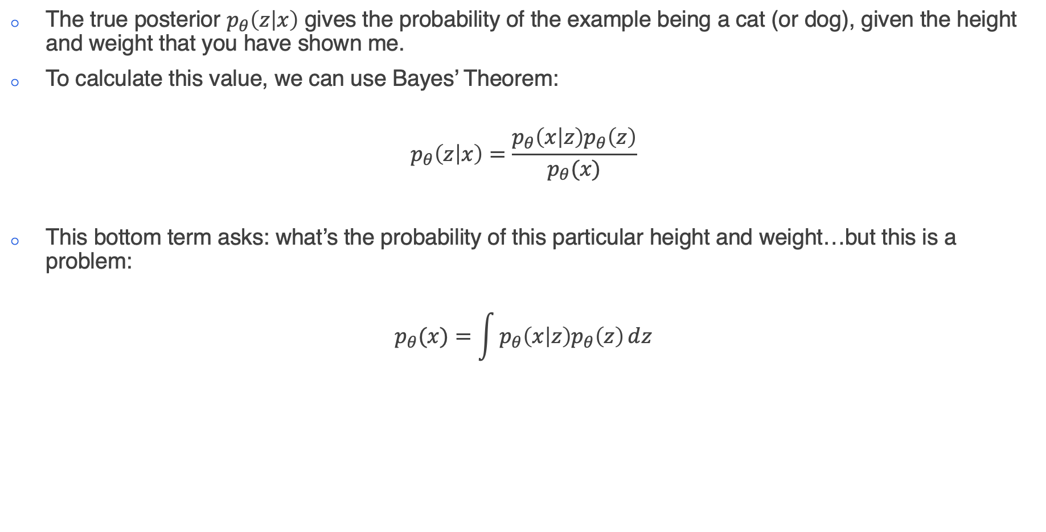
VAEs
Posterior
The true posterior $p_{θ}\left(z | x\right)$ gives the probability of the example being a cat (or dog), given the height and weight that you have shown me.
To calculate this value, we can use Bayes’ Theorem:
$$p_{θ}\left(z | x\right)=\frac{p_{θ}\left(x | z\right)p_{θ}\left(z\right)}{p_{θ}(x)}$$
This bottom term asks: what’s the probability of this particular height and weight…but this is a problem:
$$p_{θ}(x)=\int{p_{θ}\left(x | z\right)p_{θ}\left(z\right)ⅆz}$$
Problem!
We cannot solve this!
Notes:
This is the encoding process. I want the encoder to be able to accurately map the inputs to the CORRECT latent variable value. In this case it’s like a classifier – given some heights and weights, give me a 0 or 1 (for cat or dog).
In order to calculate this, we use Bayes’ Theorem.
P(x|z) we’ve seen before, but it actually isn’t going to matter what form it takes, as we’ll soon see…. And p(z) is the prior, which we’ve also seen before, and it’s just Gaussian.
But the problem is that bottom term…
This bottom equation says that for each value of z, I must first calculate p(x|z) – the probability of observing a height and weight given that z explains the data. Then I need to multiply this by how likely it is for z to occur in the population at all (i.e. the proportion of cats and dogs in this case). And I need to do this for both cats and dogs.
This is fine for cats and dogs, because z is a binary 1D feature: my encoder will map to either a single 1 or a single 0, so I only have two terms.
I do not want to do this when I have multiple latent variables can take on essentially an infinite number of values! This problem is intractable.
To reiterate, trying to find the exact mapping between the data, and the latent representation, is insoluble by any practical means.

Slide 14
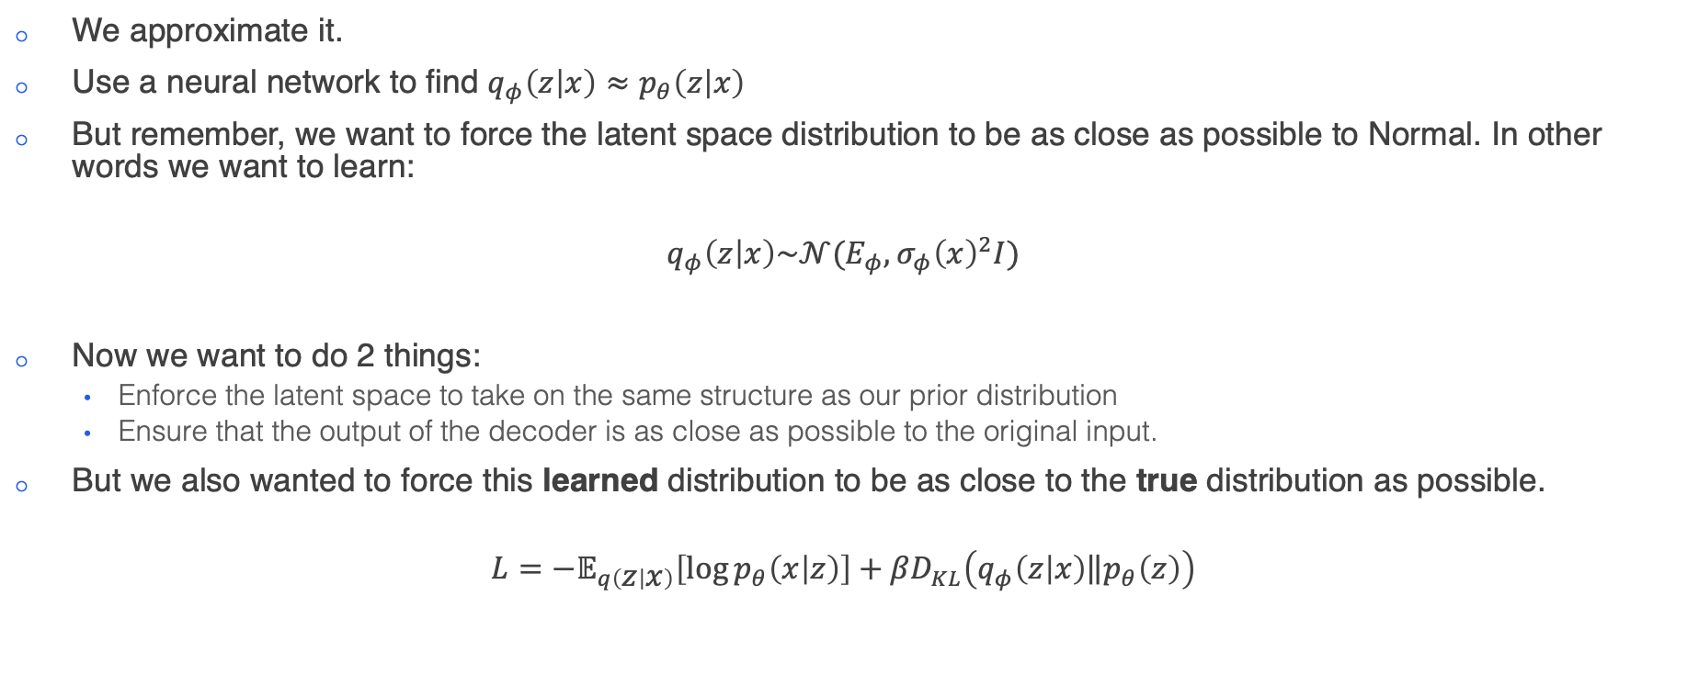
VAEs
So what do we do?
We approximate it.
Use a neural network to find $q_{φ}\left(z | x\right)≈p_{θ}\left(z | x\right)$
But remember, we want to force the latent space distribution to be as close as possible to Normal. In other words we want to learn:
$$q_{φ}\left(z | x\right)\sim 𝒩(E_{φ}, σ_{φ}{\left(x\right)}^{2}I)$$
Now we want to do 2 things:
Enforce the latent space to take on the same structure as our prior distribution
Ensure that the output of the decoder is as close as possible to the original input.
But we also wanted to force this learned distribution to be as close to the true distribution as possible.
$$L=−𝔼_{q\left(z | x\right)}\left[\log{p_{θ}\left(x | z\right)}\right]+{βD}_{KL}\left(q_{φ}\left(z | x\right)\left\|p_{θ}\left(z\right)\right.\right)$$
Notes:
We actually can’t do gradient descent on this, so we have to use the reparametrization trick to obtain an unbiased estimator of the gradient.
What does this look like in code…

Slide 15
U-Net
Notes:
My name is Ryan and I’m a machine learning engineer with the accelerate programme for scientific discovery. I’m just going to talk about accelerate, what we do, what we’ve done, and what we might be able to offer you.

Slide 16
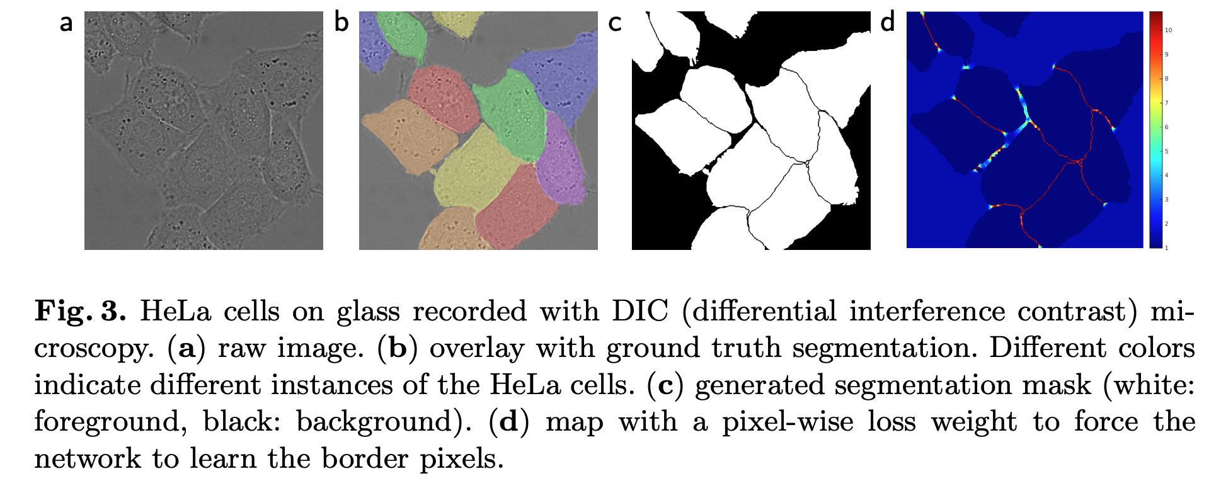
U-Net
U-Net is a classic neural network architecture
U-Net was originally developed for biomedical image segmentation.
The original paper U-Net: Convolutional Networks for Biomedical Image Segmentation was presented at MICCAI in 2015, and now has nearly 85k citations!
Notes:
U-Net was originally used for the problem of image segmentation.

Slide 17
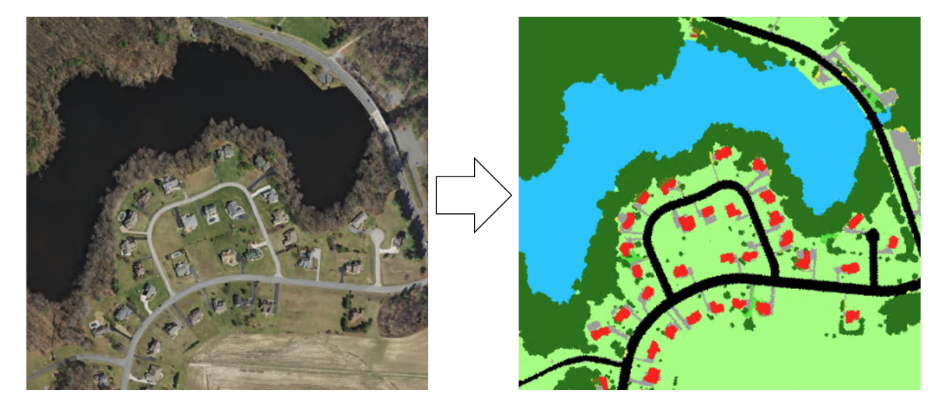
U-Net
U-Net was originally designed for semantic segmentation
The input data consists of the original image
For the label data, each corresponding pixel is given a label.
0.54 | 0.64 | 0.36 | 0.58 | 0.48
0.90 | 0.89 | 0.91 | 0.87 | 0.89
0.91 | 0.90 | 0.85 | 0.89 | 0.90
0.46 | 0.48 | 0.59 | 0.56 | 0.47
0.54 | 0.64 | 0.36 | 0.58 | 0.48
grass | grass | grass | grass | grass
road | road | road | road | road
road | road | road | road | road
grass | grass | grass | grass | grass
grass | grass | grass | grass | grass
Notes:
Specifically, it was designed for supervised image segmentation. So you already have a labelled image. There are ways to do unsupervised segmentation.

Slide 18
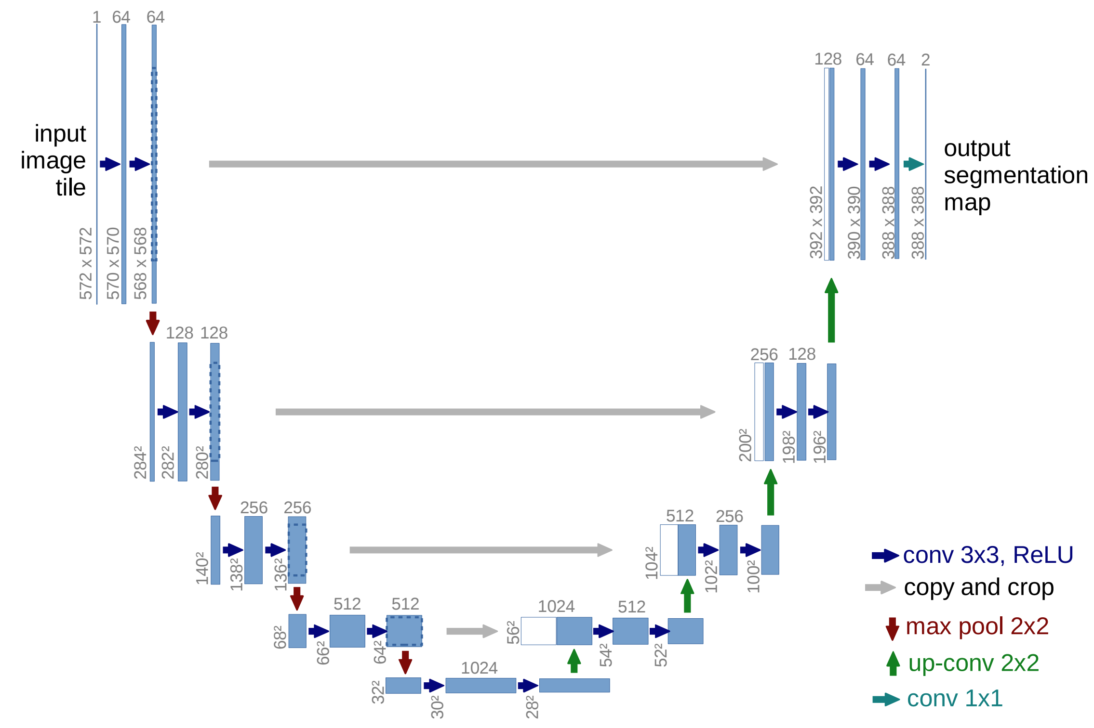
U-Net
Perhaps unsurprisingly, U-Net has a distinctive U-shaped architecture…
Notes:
U-Net is essentially made of the same components as the Autoencoder, and we follow a similar idea of making our images smaller and smaller and then expanding them again. However, there are some key differences here.
The first is the use of convolution.

Slide 19
U-Net
There are some key components of U-Net that are worth going over…
Convolution
Residuals
Upsampling
Pooling
Normalization

Slide 20
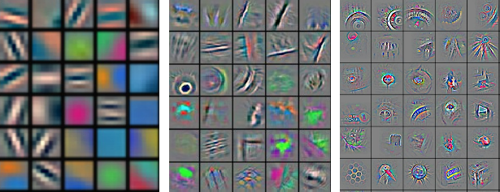
U-Net
Convolution was a major advancement in machine vision
Gradient-based Learning Applied to Document Recognition, 1998, LeCun et al, ~65k citations
ImageNet Classification with Deep Convolutional Neural Networks, 2012, Krizhevsky et al, ~130k citations
Zeiler, Matthew D., and Rob Fergus. "Visualizing and understanding convolutional networks.”
Computer Vision–ECCV 2014: 13th European Conference, Zurich, Switzerland, September 6-12, 2014,
Proceedings, Part I 13. Springer International Publishing, 2014.
Notes:
Yann LeCun went on to win the Turing Award in 2018, and is the current Chief AI Scientist at Meta
Yoshua Bengio also one a turing award in 2018, and has the highest h-index of any computer scientist
The ImageNet paper authors immediately formed a company which was bought out by Google for the nice sum of $44m
Ilya Sutskever went on to be a co-author on the AlphaGo paper, and was a cofounder of OpenAI
Hinton also received the Turing award in 2018 and worked for Google Brain for over 10 years.
Here we can see the different types of features that these filters pick out as we progress through the layers of a convolutional neural network.
To begin with, we just see simple shapes, like lines in different orientations
Then as we go deeper, we being to see real structure within the filters, as if they are picking out specific objects like eyes.

Slide 21
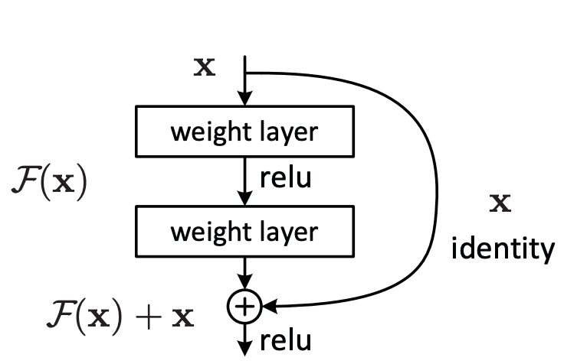
U-Net
Like CNNs, residual neural networks were a major step forward for deep learning.
Deep Residual Learning for Image Recognition, He et al, Microsoft Research, 2015 ~210k citations
Most neural networks now use residual connections.
After AlexNet, the main idea was simply to make the neural network bigger.
However, after a certain point, error appeared to increase that was not attributable to overfitting.
Instead of trying to learn a complicated function to transform the inputs directly to the outputs, we learn: “what do we need to change in order to transform the inputs to the outputs”
The trick is to add skip connections:
Notes:
The Resnet paper is the most highly cited paper on Google Scholar.
Deeper networks leads to a higher training error, but it is not due to overfitting. The argument for this is that:
Suppose I start with a shallow neural network.
In principle I should be able to just take my neural network, and add a bunch of layers afterwards that just learn the identity function. So it must be related to how the network weights are being optimized.

Slide 22
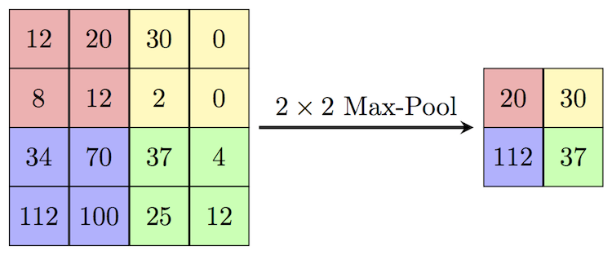
U-Net
Pooling
Yamaguchi et al. "A neural network for speaker-independent isolated word recognition." 1990
It’s a very simple concept:
Pass a window across the filter and take the maximum value
The maxpool operation is defined by the stride and the filter size
It preserves important features and downscales to make computation less intense
Makes the networks somewhat equivariant.

Slide 23
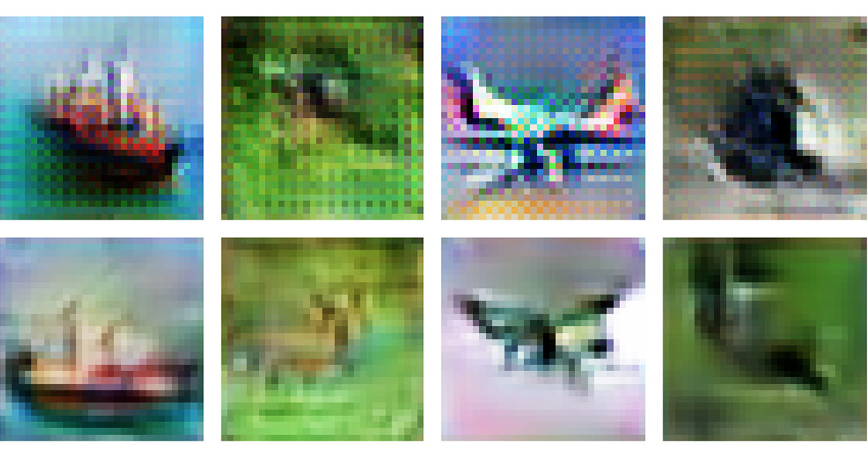
U-Net
Upsampling
In an autoencoder using convolutional filters, we have to go from our small bottleneck back to the original image size.
We use up sampling for this.
In PyTorch there are two main ways:
UpSample2D (untrainable)
ConvTranspose2D (trainable)
From the original U-Net paper:
Every step in the expansive path consists of an upsampling of the feature map followed by a 2x2 convolution (“up-convolution”)
Stable diffusion uses a similar method
Notes:
The main difference between upsampling and transpose convolution is the trainable weights. In upsampling, the weights are not trained and we interpolate.
ConvTranspose can lead to these checkerboard artifacts.

Slide 24
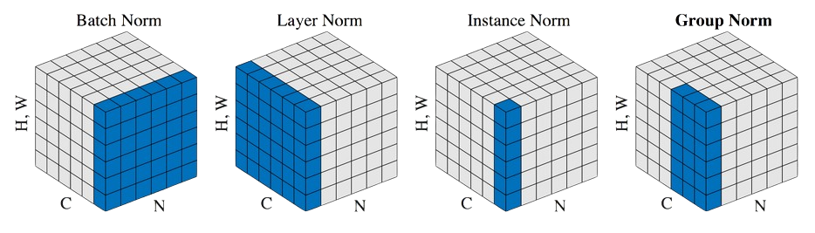
U-Net
Normalization
There are a few different types of normalization:
Notes:
In this picture C represents the different filters, N is a particular image, and H, W are the image (or filter) features

Slide 25
U-Net
Let’s look at the U-Net architecture again…

Slide 26
CLIP
Notes:
My name is Ryan and I’m a machine learning engineer with the accelerate programme for scientific discovery. I’m just going to talk about accelerate, what we do, what we’ve done, and what we might be able to offer you.

Slide 27
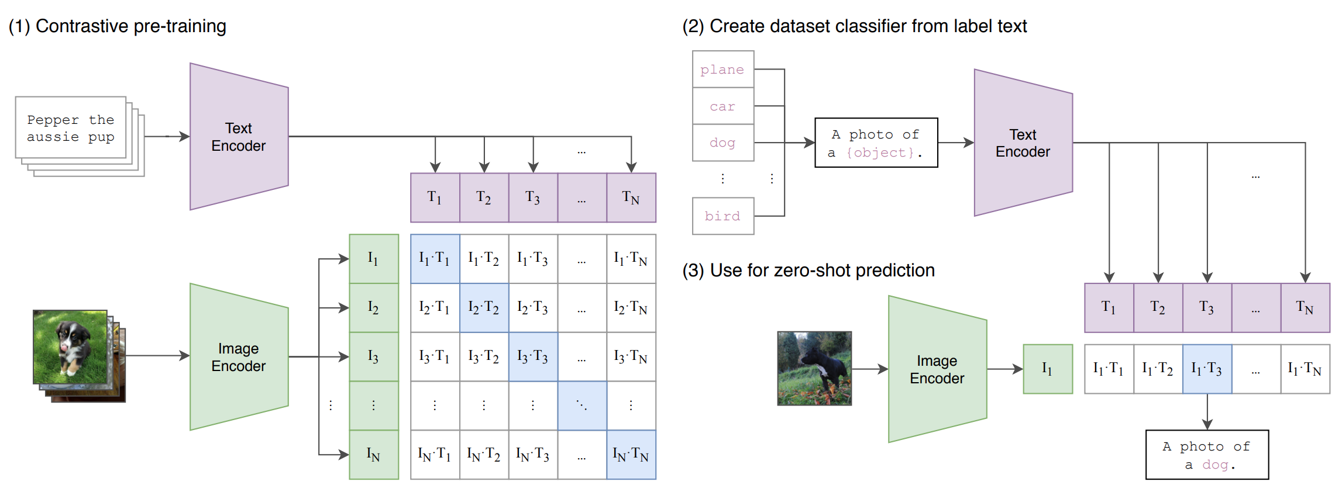
CLIP
Contrastive Language-Image Pre-training
Learning Transferable Visual Models for Natural Language Supervision, Radford et al, 2021, ~17k citations
Takes in images and texts and connects them together
Radford, Alec, et al. "Learning transferable visual models from natural language supervision." International conference on machine learning. PMLR, 2021.
Notes:
Scrape a bunch of photos (400m to be precise) and the accompanying text. Ask the question: How likely does a piece of text go with an image?
The prompt becomes important.
Take an image, and pass it through an encoder which will produce a vector in latent space. We do this for every image in a batch.
Take the text corresponding to the image and pass it through a different decoder which will produce another vector in latent space.
Now ask the model, which of the text is most appropriate for each image.
In training we are trying to maximize the cosine similarity between correct image-caption vector pairs, and simultaneously minimize the similarity scores between all incorrect pairs.
When running in inference mode, we are calculating the similarity scores between the vector of a single image with all possible caption vectors.
In our code, the batch size, and therefore the similarity matrix, is quite small. For CLIP, the similarity matrix is 20,000 x 20,000! This is a huge batch.
The contrastive loss function can be tricky to wrap your head around.
We take a single image embedding.
Find the cosine similarity between that embedding and the embedding of every text label.
Take the similarities and apply a softmax function to find a probability distribution over the text labels.
This tells you how likely does this image correspond to the possible text embeddings.
And then you do this for every image.
…And then do it for the text labels.
Take the average of these two losses.
CLIP did a few novel things:
Scraping text/image pairs
Efficient training on large batches
Zero-shot classification of images
Contrastive loss function

